Slide 1
Predicting In-hospital Mortality of Patients in the Paediatric ICU
Shenda Hong, and Collaborators
Jun 18, 2020

Slide 2
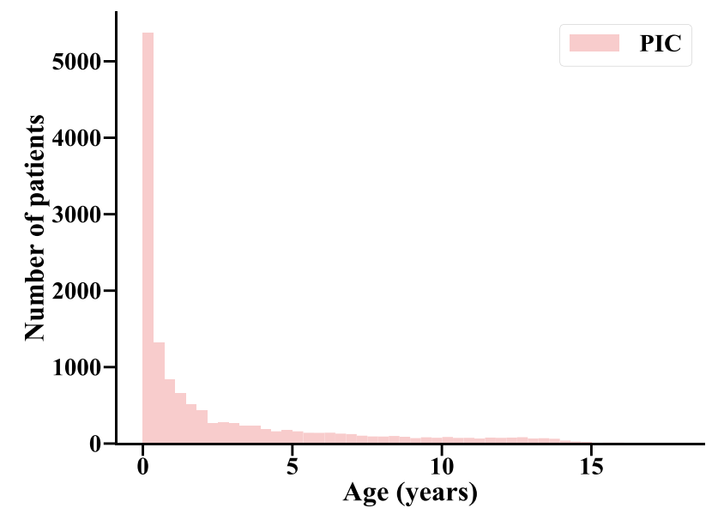

Data
PIC (Paediatric Intensive Care) database is a large, single-center database comprising information relating to patients admitted to critical care units at the Children's Hospital of Zhejiang University School of Medicine. It is a supplement to the well-known MIMIC database which provided a real clinical database for many data science researchers and supported many research projects. We hope this open paediatric intensive care database will also help improve the quality of intensive care for children.
http://pic.nbscn.org
Xian Zeng#, Gang Yu#, Yang Lu#,Linhua Tan, Xiujing Wu, Shanshan Shi, Huilong Duan, Qiang Shu* and Haomin Li*. PIC, a paediatric-specific intensive care database. Scientific Data 2020 7:14 DOI:doi.org/10.1038/s41597-020-0355-4. Available from: https://www.nature.com/articles/s41597-020-0355-4

Slide 3
Data
Tables
ADMISSIONS.csv
CHARTEVENTS.csv
LABEVENTS.csv
Extract min/max values in the first 24 hours after admission
Total 1109 featrues
Impute missing values with 0
No scale

Slide 4
1109 features
Feature Selection by Machine Learning Model
Framework
5 fold cross validation
Average feature importance score from RF
Train stepwise LR, find the best set of features
29 features
25 features
Feature Selection by Pediatrician
CV1
CV2
......
CV5
Model 1
Model 2
......
Model 5
Final Model
Weight Ensemble

Slide 5
方法创新点
Joint feature selection
使用机器学习模型从1109个特征中初步筛选出29个特征
领域专家从上述29个特征中进一步筛选，去除无临床意义的特征，得到25个特征
Weights ensemble
Build base models from 5-fold data split
Ensemble via weights average

Slide 6
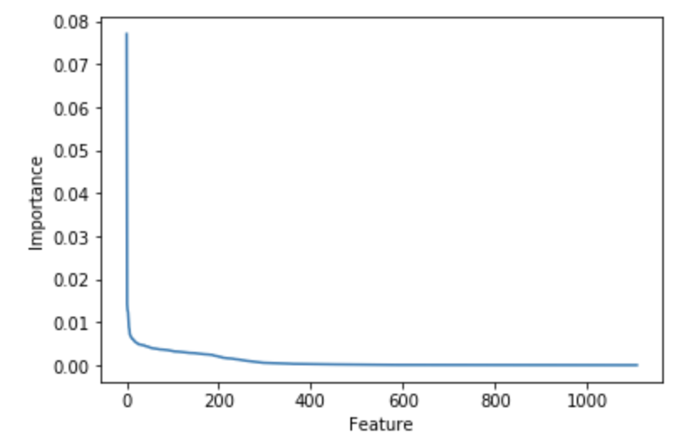
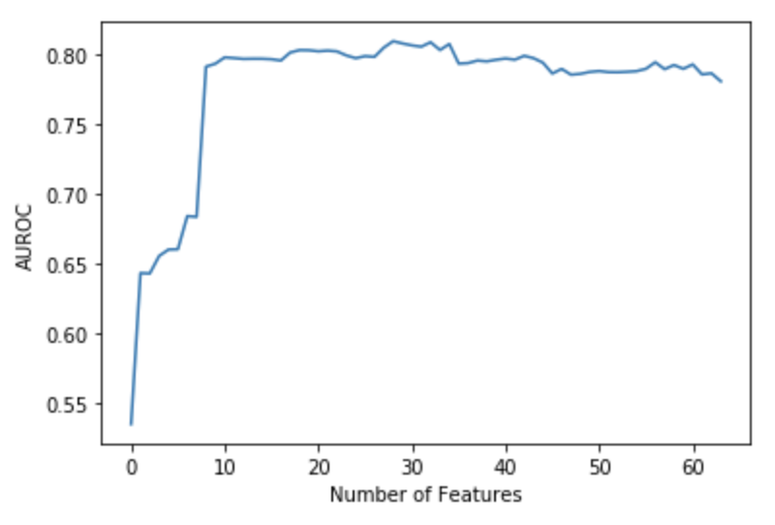
1 - Joint Feature selection
Feature selection can
Simplify the final model
Promote performance
1109 features
29 features
25 features
Feature importance score from RF
Step-wise LR
Experts

Slide 7
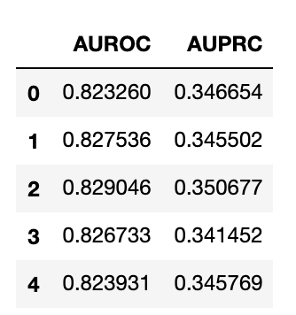
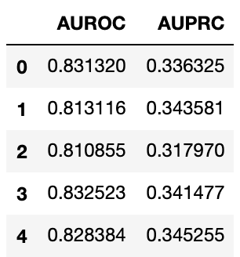
2 - Weights Ensemble
Weight Ensemble can
Fully utilize data
Promote generalizability
Split data into 5-fold
Training base LR model on every 4-fold with 25 features
Average coefficients and bias for 5 models to get final model
Fold 1
Training set results (left) is comparable with test set results. We can conclude that no overfitting happens.
Fold 2
Fold 3
Training Data
Fold 4
Test Data
Fold 5

Slide 8
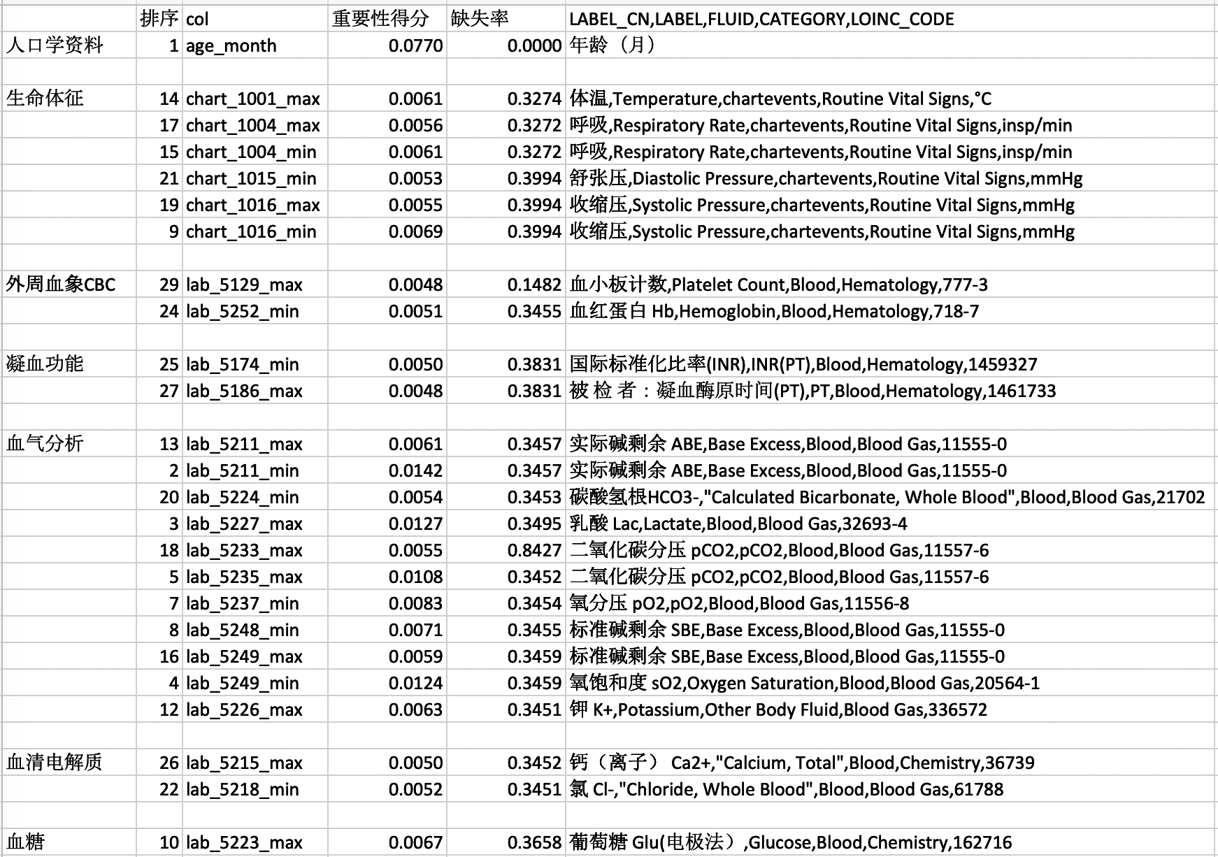
Final Model
Death Probability = sigmoid(
-0.002198*age_month + -0.010771*chart_1001_max + 0.000724*chart_1004_max + -0.000828*chart_1004_min + -0.007192*chart_1015_min + 0.006699*chart_1016_max + -0.013102*chart_1016_min + -0.003065*lab_5129_max + -0.004625*lab_5252_min + 0.041561*lab_5174_min + 0.002169*lab_5186_max + 0.018668*lab_5211_max + 0.018158*lab_5211_min + 0.011761*lab_5224_min + 0.075337*lab_5227_max + 0.017437*lab_5233_max + 0.019721*lab_5235_max + 0.477498*lab_5237_min + -0.037506*lab_5248_min + -0.056775*lab_5249_max + -0.016579*lab_5249_min + 0.021963*lab_5226_max + -0.425055*lab_5215_max + -0.033721*lab_5218_min + 0.033321*lab_5223_max + -1.557264)

Slide 9
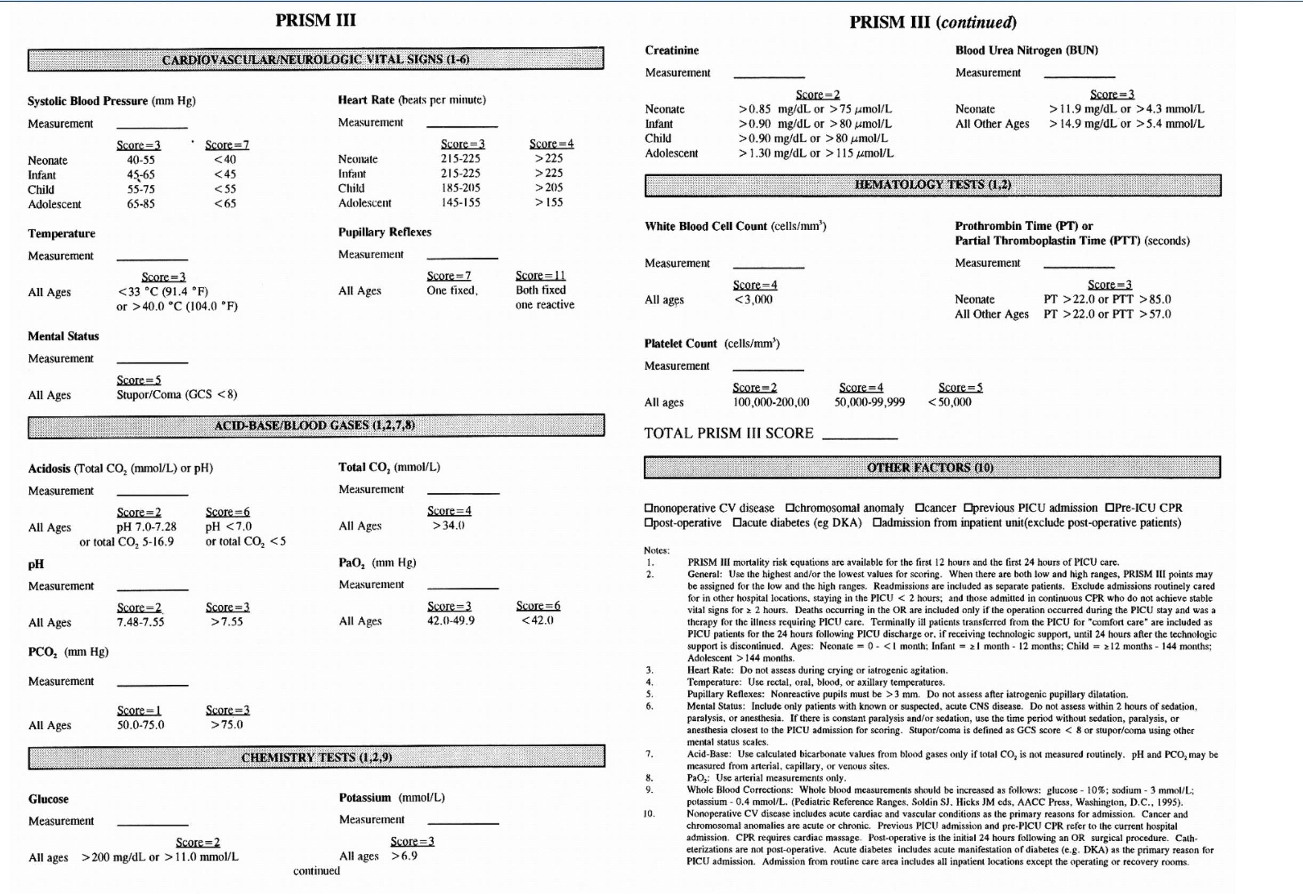
Baseline Model：
PRISM III

Slide 10
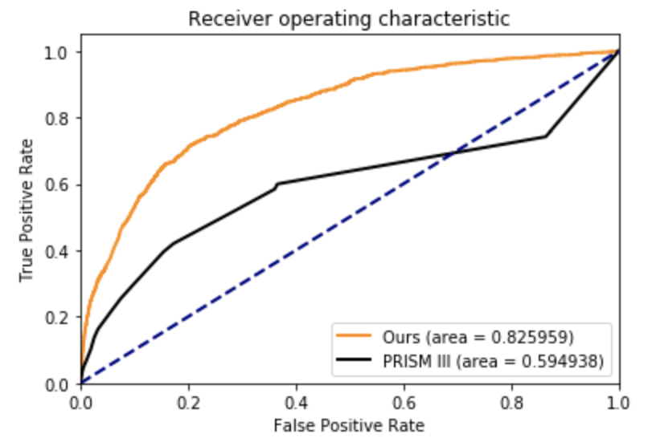
Results
Reproducible code is publicly available at https://github.com/hsd1503/PIC

Slide 11
TODO
医院里是否有外部数据可以提供测试？
除了PRISM_III是否有别的方法需要对比？
合适的目标期刊

Slide 12
Thanks!

